Slide 1
The role and IMPORTANCE OF THE
CEMENT INDUSTRY TO LAUNCH
ECONOMIC DEVELOPMENT
Koen Coppenholle – CEMBUREAU Chief Executive
Meeting with Government Authorities of the Republic of Serbia
3 July 2014

Slide 2
TABLE OF CONTENT
CEMBUREAU: a brief presentation
EU-Serbia: the context
The societal challenges for all of us
How cement and concrete can contribute
How we can cooperate on policy and implementation of the EU “acquis” ?
Our core messages through our publications

Slide 3
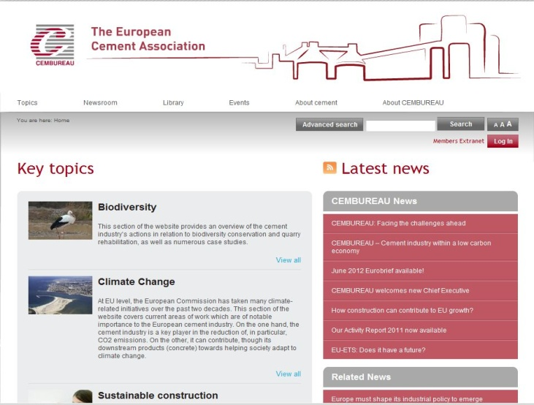


the European cement association
A BRIEF PRESENTATION
Representative organisation of the cement industry in Europe, based in Brussels
Primary objective = advancing Members’ interests through active representation of the European cement industry at European and international levels by:
  Enhancing the competitiveness of the cement industry
  Developing environmental know-how
  Promoting cement and concrete
  Drive sustainability throughout the supply chain

Slide 4
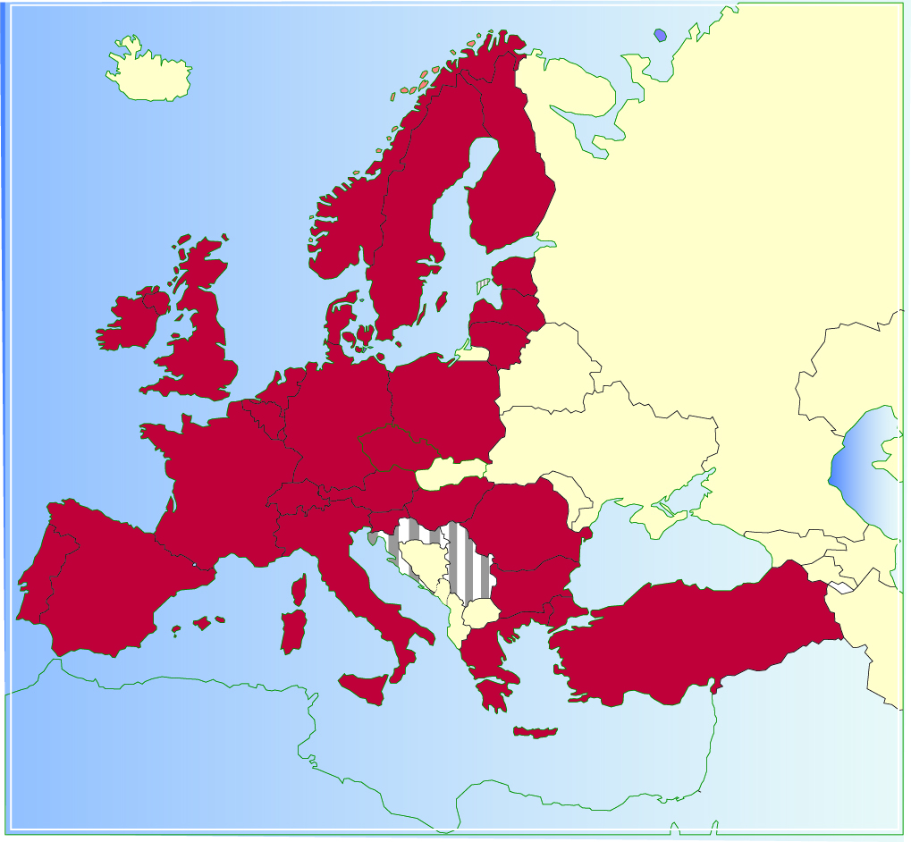
OUR MEMBERS AND ASSOCIATE MEMBERs
Today: 29 Members
(27 full Members and
2 Associate Members)
  Full Members = national cement industry associations and cement companies of the European Union (with the exception of Cyprus, Malta and Slovakia) plus Norway, Switzerland and Turkey
  Croatia and Serbia are Associate Members of CEMBUREAU
S
FIN
N
EST
IRL
DK
LV
LT
UK
NL
PL
B
D
L
CZ
F
CH
A
H
SI
HR
RO
P
E
I
RS
BG
GR
TR

Slide 5



… TO WHOM DO WE REACH OUT ?
Regular contact with
other stakeholders
Present in legislative and
political process
NGOs
European Commission
CEMBUREAU
and its
MEMBERS
Think tanks
European Parliament
Other industry
associations and alliance
Trade unions
Council of the EU
National governments
International organizations

Slide 6
EU-Serbia : the context
56% of Serbian trade is with the EU
Strong economic interdependence with EU Member States
Serbia already close EU partner through Interim Agreement on Trade (2008) and Stabilisation and Association Agreement (01/09/2013); Negotiating Framework and First Accession Conference
“National Convention on EU”: can we be involved?

Slide 7

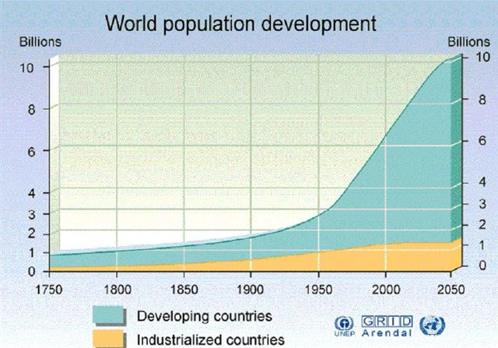
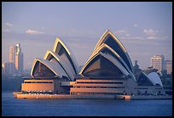
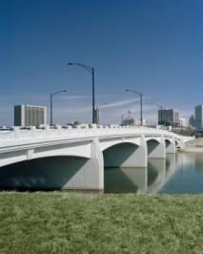


SOCIETAL CHALLENGES FOR ALL OF US
GROWING POPULATION
GLOBAL WARMING / ENERGY
SECURITY OF SUPPLY & EFFICIENCY
LINKING PEOPLE THROUGH
TRANSPORT NETWORKS
AFFORDABLE HOUSING / ECONOMIC CRISIS
RESOURCE EFFICIENCY / HOW TO GROW WITH
USE OF LESS PRIMARY RESOURCES?

Slide 8
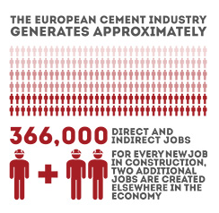
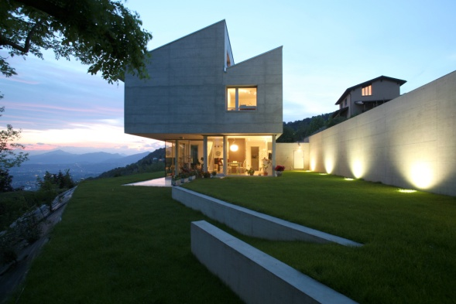
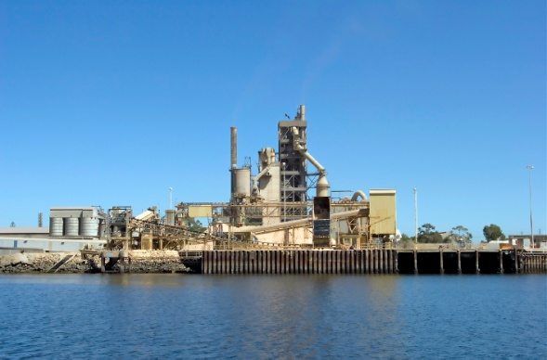
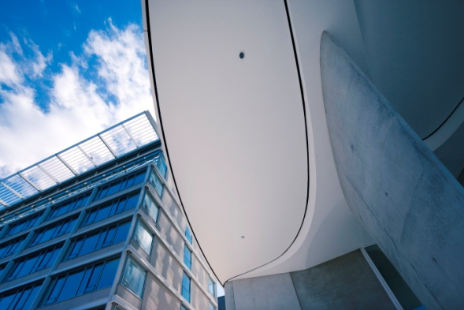
HOW CEMENT AND CONCRETE CAN CONTRIBUTE
Global industry, strong local commitment
Local supply chain
366,000 employed in concrete and cement (EU 28 + Turkey)
Multiplier effect on economy / construction
Efficiency in cement processing
CO₂ emissions/t cement reduced from 719 in 1990
to 660 in 2010
Steady increase of use of alternative fuels and raw
material substitution
Downstream: unique product characteristics of concrete
Durable
Resilient
Thermal efficient
Affordable
Cement and concrete key to sustainable construction

Slide 9
HOW WE CAN COOPERATE
YOUR PRIORITY AREAS
Create investment and industrial cooperation climate (Art. 93-94 SA)
Enhance waste management and air quality legislation (2013 Progress Report)
Design comprehensive climate and energy policy (2013 Progress Report)
Transpose, implement and enforce “acquis” (par. 31 of Accession Negotiating Framework)
OUR PRIORITIES
Full local supply chain from quarry to end-product / local jobs & growth
Continue our focus on co-processing as combination of material recycling and energy recovery
Integrated and investment
/ innovation enhancing 2030 climate
& energy policy
Ensuring proper and same application of EU legislation in all Member States / need for level playing field

Slide 10
PRIORITY 1: INVESTMENT: THE FACTS
ROCE below cost of capital over past four years
Capital intensive: cost of new plant (1 MM t capacity)
= EUR 250-300 MM
Energy intensive: energy costs = 30% of OPEX
Long term investment cycles

Slide 11
PRIORITY 1: INVESTMENT
WHAT WE CONTRIBUTE
WHAT WE EXPECT
Local growth and jobs, local products for local markets
Cement & concrete = EUR 56 bn added value to Europe
545,000 people employed
Offers building and infrastructure solutions for tomorrow / EUR 1 in construction = EUR 3 for economy
Stable and predictable legal framework allowing for long-term investments
Competitive energy prices
Strong policy focus on innovation and R&D support
Infrastructure spending under fair public procurement rules

Slide 12
PRIORITY 2: WASTE MANAGEMENT: THE FACTS
EU28 THERMAL ENERGY CONSUMPTION 2011 Breakdown (%)
The share of fossil fuels has dropped by 31.8% compared to 1990
Alternative fossil fuels and biomass have increased their shares by 23.3% and 8.5% respectively
Region | YEAR | Alternative Fossil Fuels | Biomass | Conventional Fossil Fuels
EU 28 | 1990 | 2.3 | 0.1 | 97.6
 | 2000 | 7.8 | 1.2 | 91.0
 | 2005 | 11.2 | 3.6 | 85.2
 | 2006 | 13.9 | 4.4 | 81.7
 | 2007 | 15.3 | 4.1 | 80.6
 | 2008 | 16.9 | 5.1 | 78.0
 | 2009 | 22.2 | 6.2 | 71.7
 | 2010 | 24.8 | 5.9 | 69.2
 | 2011 | 25.6 | 8.7 | 65.7

Slide 13
PRIORITY 2: WASTE MANAGEMENT
WHAT WE CONTRIBUTE
WHAT WE EXPECT
7 MM t of alternative fuels used in 2011, 6 times more than in 1990, saving 17MM t CO₂/eq
Target: 60% of kiln energy from alternative fuels by 2050 (40% from biomass)
Replace fossil fuels with waste materials which would otherwise have been incinerated or landfilled
Close to 100% of material input is recovered or recycled in production process
Policy to support waste treatment which combines energy recovery and material recycling
Level playing field for access to biomass
Waste legislation to discourage landfill or waste with calorific value or containing other recoverable resources
R&D to support co-processing

Slide 14
PRIORITY 3: CLIMATE & ENERGY: THE FACTS
Current EU ETS has not provided legal certainty (numerous changes)
No protection against price volatility hampers long-term investment planning
EU Commission proposals for 2030 do extend carbon leakage protection until 2020
2030 targets (-40% GHG reduction; 43% for ETS sectors) fail to consider abatement potential per sector / unachievable for cement

Slide 15
PRIORITY 3: CLIMATE AND ENERGY
WHAT WE CONTRIBUTE
WHAT WE EXPECT
Reduced CO₂/t cement from 719 kg in 1990 to 660 kg in 2010
Wet kilns replaced with energy-efficient dry kilns (for 90% of clinker produced)
Improved grinding technologies + enhanced thermal energy consumption
Develops concrete technology that allows to build buildings with 60% less energy use and CO₂ emissions compared to 20 years ago
Ambitious but realistic and predictable legislation
Performance based free allocation based on recent reference years
Reasonable and achievable benchmark
Include direct and indirect costs in compensating competitiveness loss with third countries
Use auctioning revenue for R&D&I

Slide 16
PRIORITY 4: TRANSPOSE, IMPLEMENT, ENFORCE
Cement industry has a strong compliance record
Participates in EU stakeholder meetings but is also actively engaged in organized industry engagement
(e.g. Sevilla process for emissions legislation)
REACH: no registration for cement clinker and cement / specific type of fluedust is registered (consortium agreement created)
We welcome the Serbian new legislation on business impact assessments
CEMBUREAU HAPPY TO PARTNER ON THE “NATIONAL PLAN FOR THE ADOPTION OF THE ACQUIS” FROM THE REPUBLIC OF SERBIA

Slide 17

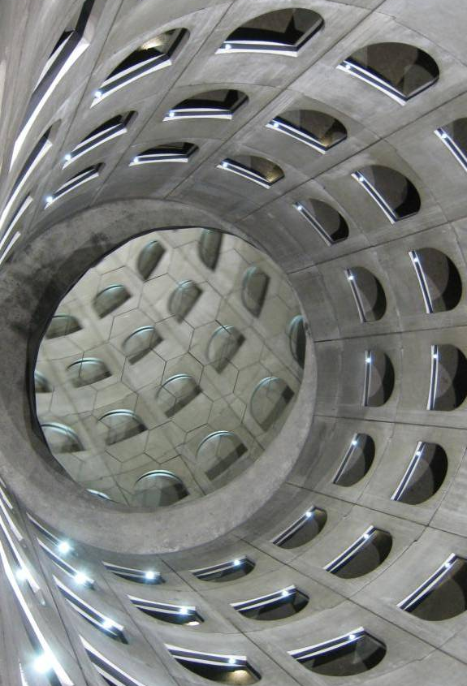


OUR CORE MESSAGES THROUGH OUR PUBLICATIONS
Boston Consulting Group
“The Cement industry: A Strategic
Contributor to Europe’s Future”
The CEMENT sector needs the right policy framework to remain
competitive
“The Role of Cement in the 2050 Low
Carbon Economy”
… and to innovate and improve performance …
“The Concrete Initiative”
“Concrete: the Backbone of
Sustainable Construction”
… so that we can build the society
of tomorrow with our unique
product: CONCRETE

Slide 18
we NEED TO BE ECONOMICALLY SUSTAINABLE and competitive
The cement industry has
long term investment cycles and is capital-intensive
Energy costs representing 30% of operating costs
Return on capital over the past four years well below the cost of capital
The industry needs
continued access to affordable energy and raw materials
stable legal framework that provides long-term investment security
The Cement Sector: A Strategic Contributor to Europe's Future
access to skilled workers and good labour mobility

Slide 19
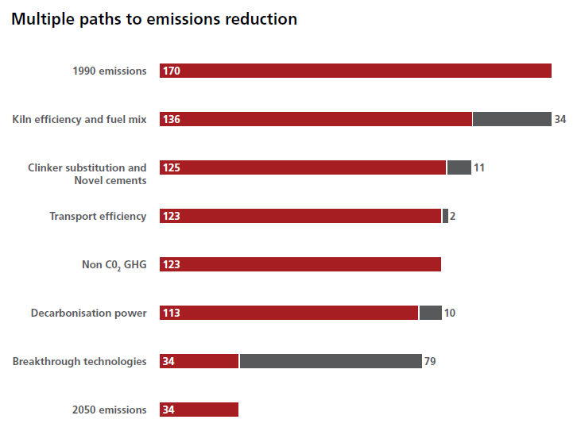
WE CAN CONTRIBUTE TO a SUSTAINABLE FUTURE
The role of cement in a 2050
low carbon economy
(the CEMBUREAU “Roadmap”)
How much CO₂ emissions reduction can we achieve by 2050?
32% without CCS; 80% with CCS
http://lowcarboneconomy.cembureau.eu/
Five parallel routes with strong contribution of alternative fuel use to the targets
Reduction effort focused on cement manufacturing process
… but we need to highlight the contribution of our downstream products to the low carbon society of tomorrow (energy-efficiency; resilience, durability, thermal efficiency)
We can not do it alone: decarbonation of power sector; 50% increase in transport efficiency assumed

Slide 20
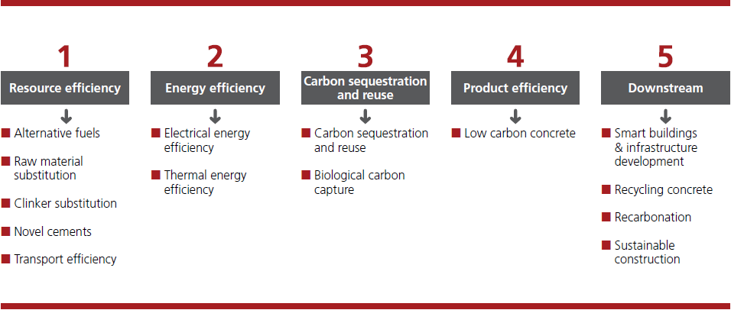
Five parallel routes TOWARDS 2050

Slide 21
WE PROMOTE A UNIQUE PRODUCT
Joint advocacy by the concrete sector (cement, precast and readymix concrete)
CONCRETE
responds to societal challenges through its
durability and resilience, affordability and proven
fire resistant properties
an engine for growth / local products for a local market / multiplier effect / widely available and
affordable
optimal “whole-life performance” thanks to
durability, thermal mass / abundantly available /
fully recyclable
www.theconcreteinitiative.eu

Slide 22

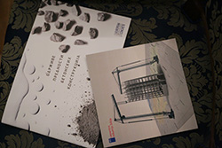
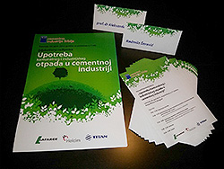
JOINT COMMUNICATION WITH OUR MEMBERS
Brochure
« Sustainable benefits of concrete structures »
Educational workshop for media representatives
on the use of municipal and industrial waste in
the cement manufacturing process

Slide 23

www.cembureau.eu

